Slide 1
Microsoft R Server
Vianey Juárez
@Vianeysitaa

Slide 2
Agenda
¿Qué es?
Integración con SQL Server

Slide 3
Microsoft R Server
Plataforma empresarial de analítica avanzada para ambientes on-premise
Totalmente compatible con scripts de R, funciones y paquetes de CRAN
Brinda la posibilidad de manejar grandes cantidades de datos y realizar el cómputo en cientos de nodos.
Notes:
Desde que se creó R, se diseñó para correr en un solo procesador. De hecho sigue funcionando así, a menos de que utilices librerías como LAPACK o BLAS (linear algebra Package and basic linear algebra). Ahora ya tenemos máquinas multi-core que pueden hacer procesamientos paralelos.
Microsoft R Server brinda unas librerías que hacen que este multi thread se pueda aprovechar.
No necesitas cambiarle nada a tu código, cuando tienes estas librerías instaladas, automáticamente las operaciones con vectores y matrices, van a aprovechar todo el poder de cómputo y serán más rápidas.
Puedes correr tus scripts de R para el análisis de información en donde viven tus datos, ya sea tener una instancia de R en tu Cluster Spark, o en tu SQL Server 2016, sin necesidad de exportar tu información para que la analices con R studio, etc.
Si tienes muchos nodos en tu cluster de spark, puedes distribuir tus workloads de analítica en esto

Slide 4




Integración con Revolution Analytics
Open Community
Commercial
Revolution R Open
Revolution R Enterprise
SQL Server
R Services
R Server
R Open
Windows
Red Hat
SUSE
Hadoop
Teradata
Notes:
Microsoft R Open, formerly known as Revolution R Open (RRO), is the enhanced distribution of R from Microsoft Corporation. It is a complete open source platform for statistical analysis and data science.
Microsoft R Open provides limited performance and scalability in comparison to Microsoft R Server. Specifically, none of the proprietary ScaleR functions and packages included with Microsoft R Server are available in standalone Microsoft R Open. Also, data that can be processed is limited to the data that can fit in server memory.
RRE for Windows will become SQL Server R Services and is part of SQL16 CTP3 and SQL Server 2016 EE
New: RRE for all other platforms become R Servers

Slide 5
Built to Scale
ScaleR
Algoritmos optimizados para ejecución paralela
Ayuda con las limitantes de memoria de Open Source R
DistributedR
Administra los recursos de cómputo
Framework para la ejecución paralela de los algoritmos de ScaleR
ConnectR
Da acceso a multiples fuentes de datos, desde archivos csv hasta bases de datos distribuidas
Notes:
ScaleR algorithms are implemented as Parallel External Memory Algorithms (PEMAs). By managing RAM and permanent storage together, PEMAs are able to analyze data beyond the limits of available memory.
Compute Faster: Most ScaleR PEMA are optimized to run faster than their open source equivalents on both small and large data sets.
Unlimited Data Size: PEMAs process data in “chunks” – moving data into memory as needed, enabling the algorithm to operate on data that far exceeds available memory.
Fast Parallel Computation: PEMAs divide work into smaller pieces, distributing them across available cores, and nodes to dramatically accelerate modeling and machine learning.
Efficient Analysis of Distributed Data: Storage of data in MPP EDWs and Hadoop clusters is distributed across many nodes of the compute cluster. By analyzing local data using local compute resources, data movement and consolidation is eliminated, providing optimum efficiency and speeding computation.
In conjunction with DistributedR, ScaleR transparently distributes analytics computations across all available resources – threads, cores, processors, and nodes
DistributedR provides consistent management of memory, cores, processors, threads and servers.
Massively Parallel Processing databases

Slide 6
R + SQL Server
Permite ejecutar código R desde SSMS
Se pueden expandir los proyectos de análisis de datos al utilizar las capacidades de SQL Server
Los paquetes de ScaleR ya son parte de SQL Server R Services
Código R se puede embeber en store procedures
Notes:
You can use R for statistical computations that are difficult to implement using SQL, but leverage the power of SQL Server to achieve maximum performance, using features such as the in-memory database engine and columnstore indexes
The package also includes functions that further boost performance and scale by pushing computations to the SQL Server computer, which typically has far greater memory and computational power. Can work over large datasets

Slide 7
Proyecto de predicción de retraso de vuelos
1 – Importar datos
2 – Pre procesar los datos (limpieza)
3 – Dividir los datos para entrenar y probar el modelo
4 – Aplicar el algoritmo de entrenamiento
5 – Predecir sobre los datos

Slide 8
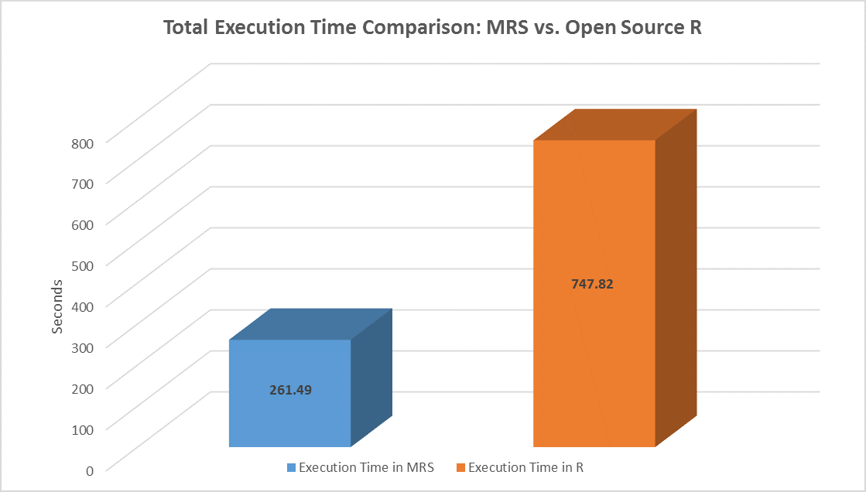
Comparación de R Open Source VS Microsoft R Server

Slide 9
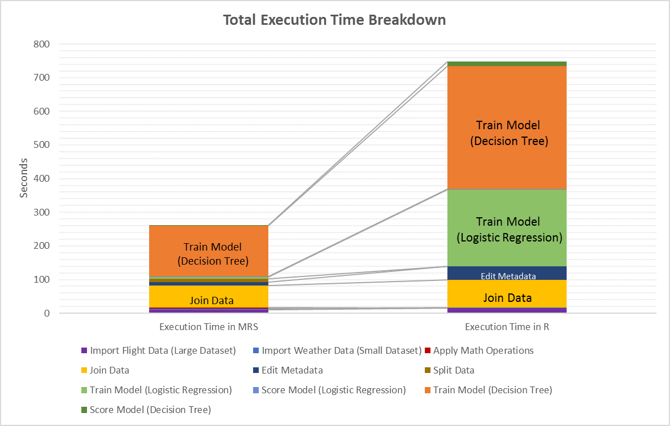

Slide 10
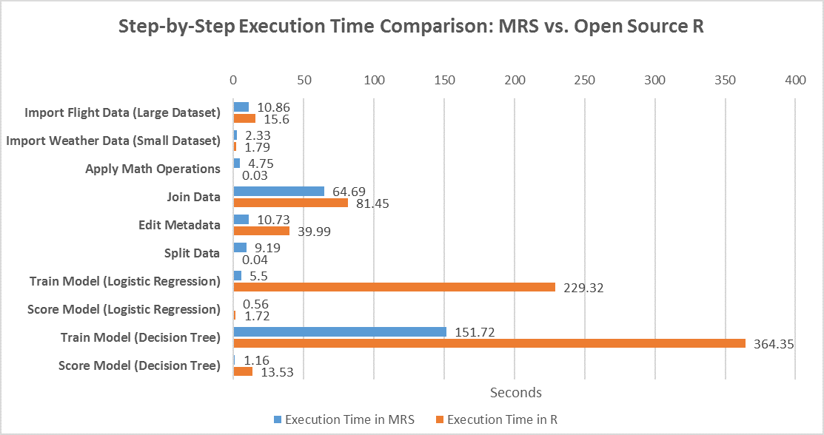

Slide 11
Otras fuentes
R for Power BI
Running R Scripts in Power BI Desktop
R Plots in Power BI Tutorial
EdX Intro to R Class:
https://www.edx.org/course/introduction-r-data-science-microsoft-dat204x
About Revolution Analytics
http://www.revolutionanalytics.com/products
Educational Resources:
DataCamp: 8 Hour Introduction to Revolution R Enterprise
https://www.datacamp.com/courses/big-data-revolution-r-enterprise-tutorial
Intro to RRE Datacamp:
https://www.datacamp.com/courses/big-data-revolution-r-enterprise-tutorial
Notes:
You can use R for statistical computations that are difficult to implement using SQL, but leverage the power of SQL Server to achieve maximum performance, using features such as the in-memory database engine and columnstore indexes
The package also includes functions that further boost performance and scale by pushing computations to the SQL Server computer, which typically has far greater memory and computational power. Can work over large datasets

Slide 12
Otras fuentes
Get Microsoft R Open and Learn more:
https://mran.microsoft.com/
ScaleR White Paper:
http://www.revolutionanalytics.com/sites/default/files/big-data-wp.pdf
Microsoft R Server
https://www.microsoft.com/en-us/server-cloud/products/r-server/
Getting Started with SQL Server R Services
https://msdn.microsoft.com/en-us/library/mt604885.aspx
Set up SQL Server R Services
https://msdn.microsoft.com/en-us/library/mt696069.aspx
Notes:
You can use R for statistical computations that are difficult to implement using SQL, but leverage the power of SQL Server to achieve maximum performance, using features such as the in-memory database engine and columnstore indexes
The package also includes functions that further boost performance and scale by pushing computations to the SQL Server computer, which typically has far greater memory and computational power. Can work over large datasets

Slide 13
Gracias!

